Slide 1




Information Encoding Standards
Members :
Sahil Talwar
Vedant
Anjali Salvin
Final Project- Group 7

Slide 2
Contents :
About team members
Project Summary
Part-1 Project Demonstration
Part -2 Question answers and Recommendation

Slide 3
About Team Members:
Sahil Talwar:
Education: B-Tech in Computer Science
Other qualifications: Have total 5 years of corporate experience
Career objective: Pursuing a career as a data analyst or data scientist
Anajli Salvin:
Education: BSc Computer Science
Other qualifications: No prior experience.
Career objective: Pursuing a career as a data analyst.
Vedant :
Education: B-Tech in Computer Science
Career objective: Pursuing a career as a business analyst.

Slide 4
Project Title: User data protected by authorization
Project Summary:
This project is built in visual studio using ASP.NET and covers the functionality of authentication and authorization.
There are three roles built in the project:
Admin Role: has privileges to create, edit, delete or view all the data. It is a super user in the project.
Manager Role: It is a subset of admin role in which manager has the privileges to create new record or can either approve or reject the existing submitted records.
Registered User Role: It is the basic role which assigned to the user after registering and has the privileges to view all the approved records and can create a new record or edit / delete the record created by that user only.

Slide 5
Part-1: Project Demonstration

Slide 6
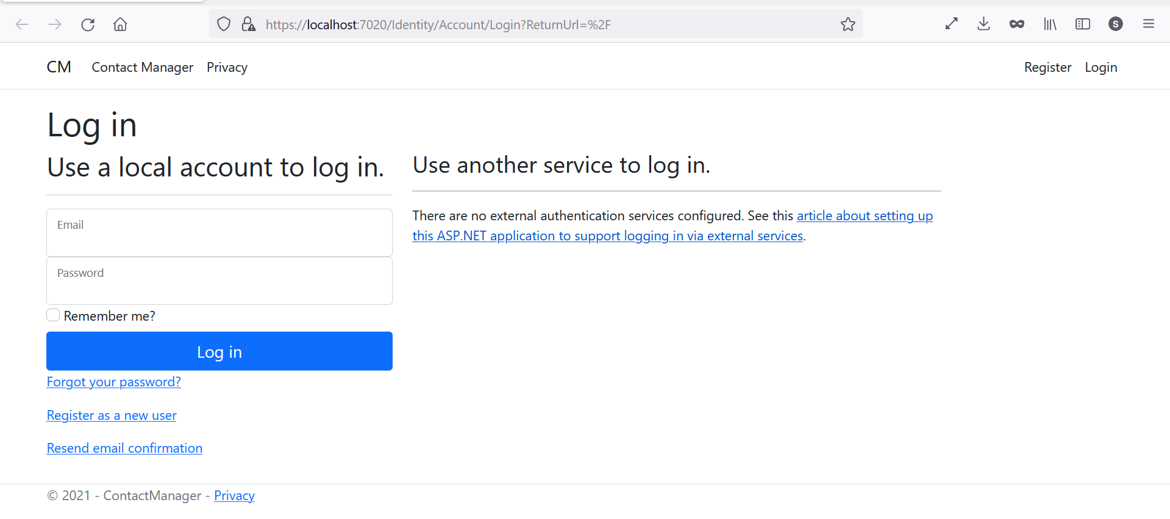
Landing Page:

Slide 7
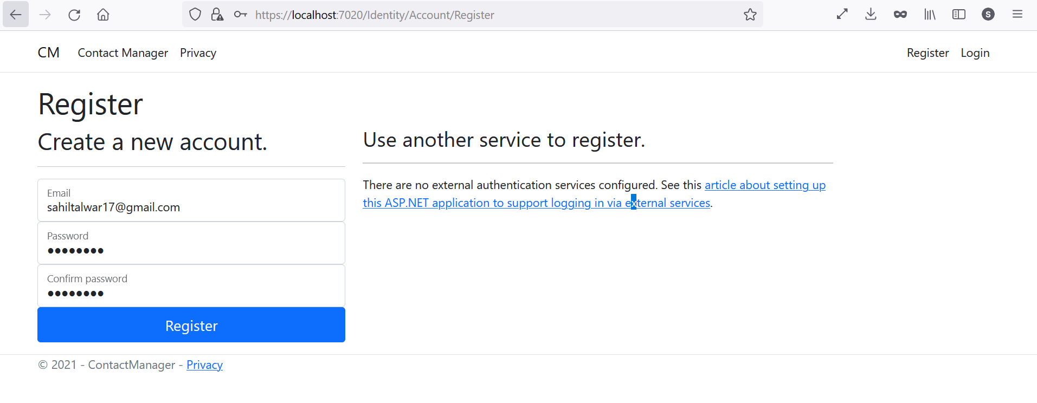
Registering New User:

Slide 8
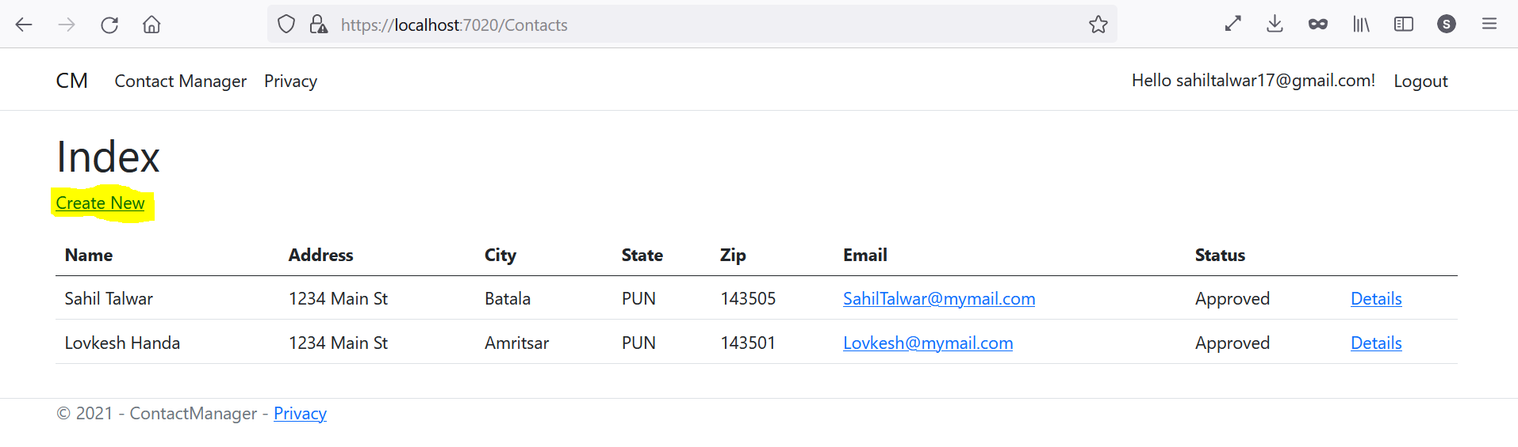
Registered user has the privileges to create the new record or even can see the records which are already in approved status.

Slide 9
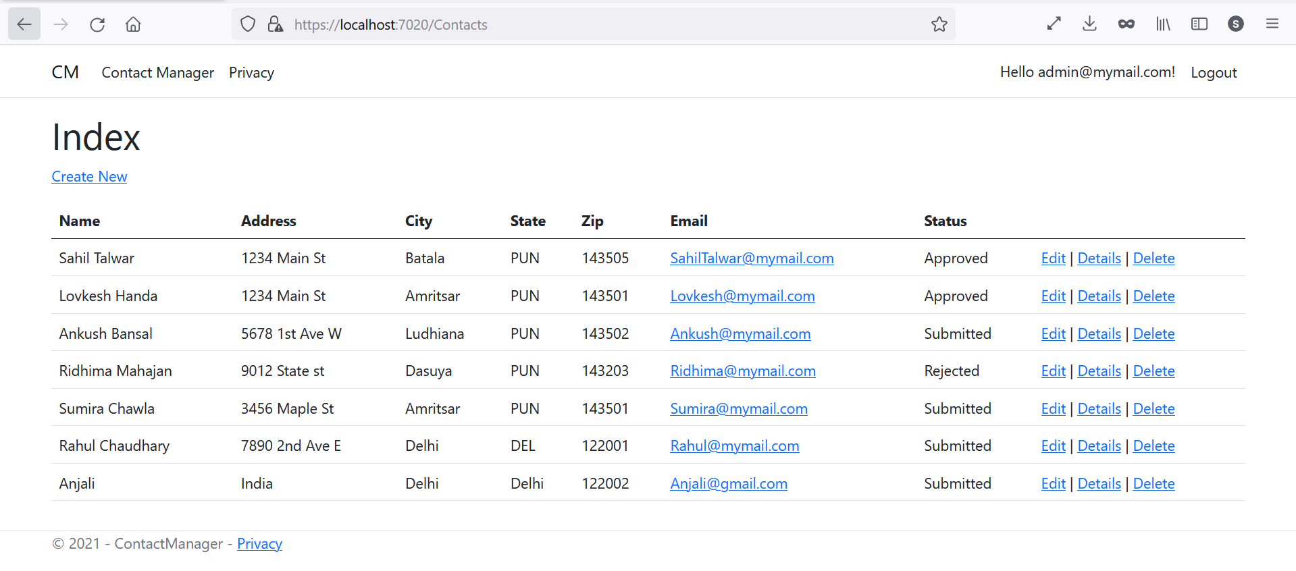
Admin Login and Roles: username: admin@mymail.com password:Pass@123

Slide 10
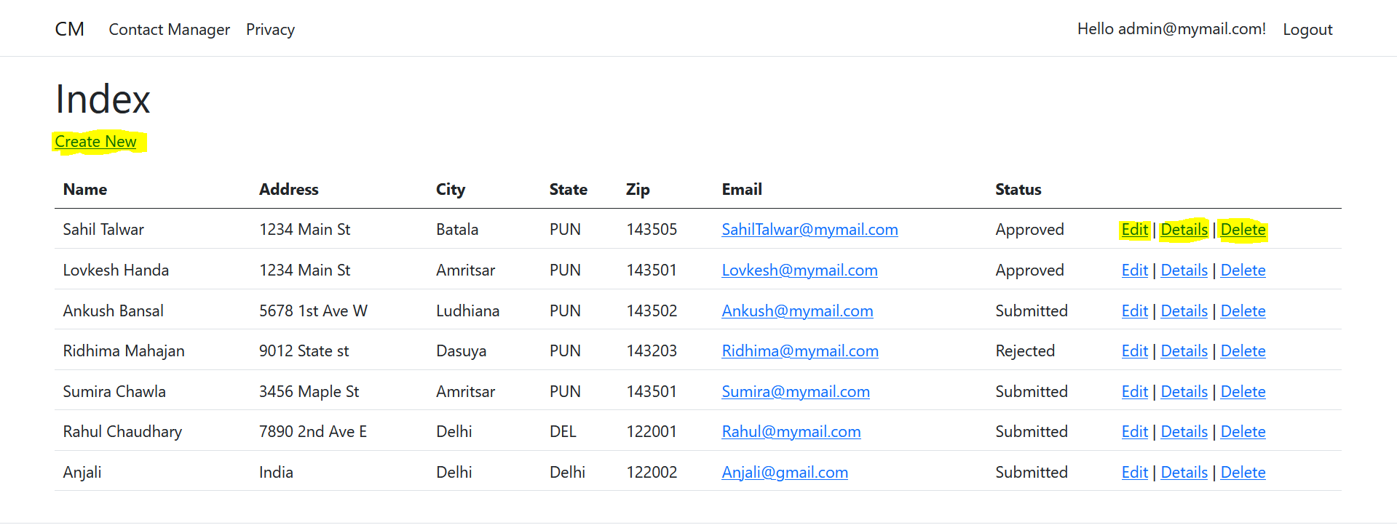
Admin user has all the privileges to create new record or can delete, edit or view the details of existing records.

Slide 11
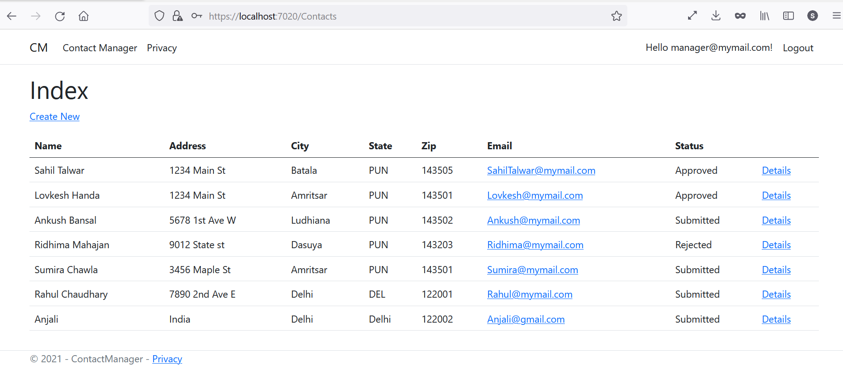
Manager Login and Roles: username: manager@mymail.com Password: Pass@123

Slide 12
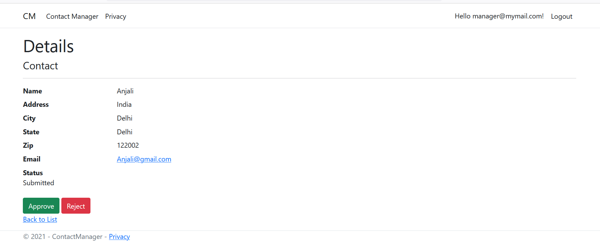
Manager has the privileges to create new record or has the authority to either approve or reject the record submitted by registered users.

Slide 13
Part-2 Questions and Answers

Slide 14
1. How can we transfer personal data securely within their network?
ASP .NET web applications provide three fundamental security operations, including Authentication, Authorization, and Impersonation.
Authentication is the process of validating a user’s identity in order to provide a certain level of access to the user. This involves receiving credential information from the user in the form of a username and password and comparing it against a database. Once validated, the user will retain access througout the designated areas of the web site application until logging out.
Three forms of authentication exist for ASP .NET web applications. These include Forms-based authentication, Passport authentication, and Windows authentication. The most commonly used form is Forms-based authentication. This allows a user to enter a username and password for access to the site. Credentials are validated against a database using a secure validation routine or stored procedure
Authorization is the process of designating and verifying access levels to specific users and areas of the web application. Administrative users typically have access to all levels of the software while basic users are often restricted.
Impersonation is the process of allowing the web application to execute commands under the security context of another user. If the web application requires the ability to execute background administrative commands on the server, impersonation can be used to execute those commands under a different (and temporary) security context. Access to those resources will be granted or denied based on the identity of the impersonated user.

Slide 15
2. What security protocol is best for transferring personal files?
SECURE FILE TRANSFER PROTOCOL (SFTP)
SFTP transfers files with the Secure Shell (SSH) connection. SFTP is an encrypted file transfer network protocol that can enable a remote login to operate over a network that lacks security. SFTP offers encryption of commands and data and prevents passwords and sensitive information from open transmission over the network.
FILE TRANSFER PROTOCOL – SECURE (FTPS)
FTPS (short for File Transfer Protocol Over SSL/TLS) offers encryption and uses an application layer wrapper, known as Secure Sockets Layer (SSL) to enable secure and private communications across a network. Like SFTP, FTPS uses strong encryption algorithms (like AES and Triple DES) to safeguard data exchange.
HYPERTEXT TRANSFER PROTOCOL – SECURE (HTTPS)
HTTPS secures websites when users are providing sensitive information like credit card numbers or other personal information. The protocol offers multiple layers of data protection including data integrity, encryption, and authentication.
Top secure file transfer protocols include SFTP, FTPS, and AS2. Each of these offers stronger encryption than standard FTP, as well as additional safeguards, including keys, passwords, and certificates to authenticate users or connections.

Slide 16
3. Can we encode and encrypt images?
A picture can be encrypted in the same way that text is encrypted by software. By running a sequence of mathematical operations, called an algorithm, on the binary data that comprises an image, encryption software changes the values of the numbers in a predictable way.
Recently, I required searching out an easy way to encode and decode a file of any kind (I actually required to encode images and text files) and any size. I found many examples online, several of them did not work, or threw errors on sure file varieties.
Encryption - The process of changing data or information into a code, particularly to stop unauthorized access.
Decryption - The method of taking encoded or encrypted text or alternative information and changing it back to text that you simply or the pc will browse and perceive. This term may be used to describe a way of un-encrypting the information manually or with un-encrypting the information using the right codes or keys.
The files are uploaded for encoding and decoding of files. The AES symmetric algorithm is used for encoding and decoding of the files. The encrypted and decrypted files may be saved within folders on disk or may be downloaded to shopper user.

Slide 17
4. Our database cannot be moved from the site and we need to be able to access it externally using a secure API. Can you explain the architecture of a secure API?
API architecture refers to the process of developing a software interface that exposes backend data and application functionality for use in new applications. With an API-first architecture, you can create ecosystems of applications that are modular and reusable — which is ideal for microservices
REST API (RESTful API) is an application programming interface (API or web APl) that conforms to the constraints of REST architectural style and allows for interaction with RESTful web services.
REST API Architecture: Rest API uses Client-Server architecture.
Rest API Architecture Constraints:
Uniform Interface
Client-server
Statelessness
Cacheability
Layered system
Code on Demand

Slide 18
5.Can you recommend a secure framework for coding an API?
Django and Flask are the two most secured and easy to use frameworks used in the industry
Django and Flask frameworks use Python and REST API for the development. These frameworks are easy to use. That enables the rapid development of secure and maintainable websites. Django takes care of much of the hassle of web development, so you can focus on writing your app without needing to reinvent the wheel.
Django is used by numerous applications like Google. YouTube, and Instagram, and REST frameworks of Django are easy for creating a secure API.

Slide 19
6. What data interchange format should we use while transferring data between locations?
JSON is the most appropriate format for sending data between web servers and browsers and mobile applications. Its simple design and flexibility make it easy to read and understand, and in most cases, easy to manipulate in the programming language of your choice

Slide 20
7. How should we store our data in our many locations?
Multiple ways are there to store the data in many locations:
Traditional Method: The data is stored locally in the disk or local servers. It has disadvantages like incase of natural calamity or power failure data can be loss.
Cloud Storage: Using cloud storage we can access and upload the data from anywhere without depending on local computer. It has many pros like in case of any disaster, data will not loss and multiple copies of the data can be maintained on cloud.
Hybrid storage: Personal data can be stored locally in secured servers and the rest of the can be stored on cloud.

Slide 21
8. What are the ethical concerns related to the transmission of personal data?
Freedom from unauthorized access to private data. Inappropriate use of data. Accuracy and completeness when collecting data about a person or persons (corporations included) by technology. Availability of data content, and the data subject's legal right to access; ownership.

Slide 22
Thank you

